Slide 1
AVL Trees
COMP 282
Mahdi Ebrahimi
Slide Courtesy : ilhelm HarDouglas Wder, MMath, UWaterloo
dwharder@alumni.uwaterloo.ca

Slide 3
Back to Binary Search Trees

Slide 4
Building BST
Let’s consider building a BST (insert values starting from an empty tree)
Insert values 1, 2, 3, 4, 5, 6, 7, 8, 9 into an empty BST
If inserted in given order, what is the tree?
What big-O runtime for building the BST on this sorted input?
Is inserting in the reverse order any better?

Slide 5
Building BST
Insert values 1, 2, 3, 4, 5, 6, 7, 8, 9 into an empty BST
What we if could somehow re-arrange them
median first, then left median, right median, etc. 5, 3, 7, 2, 1, 4, 8, 6, 9
What tree does that give us?
What big-O runtime?

Slide 6
Balancing Binary Search Trees

Slide 7
BST: Efficiency of Operations?
Problem:
Worst-case running time:
find, insert, delete

Slide 8
How can we make a BST efficient?
Observation
Solution: Require a Balance Condition that
When we build the tree, make sure it’s balanced.
BUT…Balancing a tree only at build time is insufficient.
We also need to also keep the tree balanced as we perform operations.

Slide 9
Binary search trees store linearly ordered data
Best case height: Ο(log(n))
Worst case height: O(n)
Requirement:
Define and maintain a balance to ensure Ο(log(n)) height
https://en.wikipedia.org/wiki/Self-balancing_binary_search_tree

Slide 10
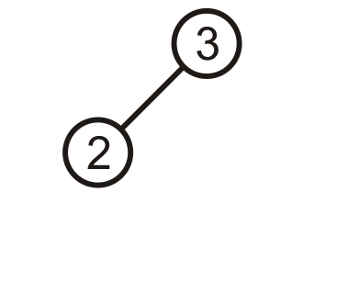
Prototypical Examples
These two examples demonstrate how we can correct for imbalances: starting with this tree, add 1:

Slide 11
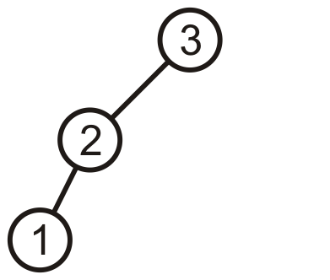
Prototypical Examples
This is more like a linked list; however, we can fix this…

Slide 12
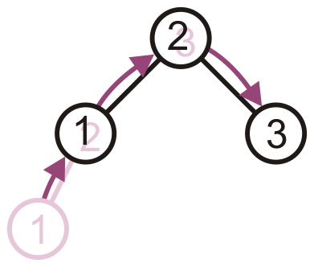
Prototypical Examples
Promote 2 to the root, demote 3 to be 2’s right child, and 1 remains the left child of 2

Slide 13
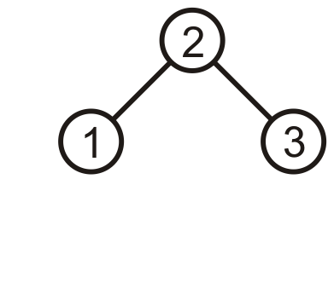
Prototypical Examples
The result is a perfect, though trivial tree

Slide 14
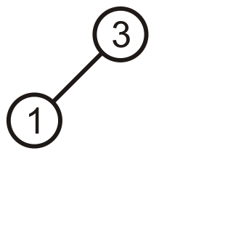
Prototypical Examples
Alternatively, given this tree, insert 2

Slide 15
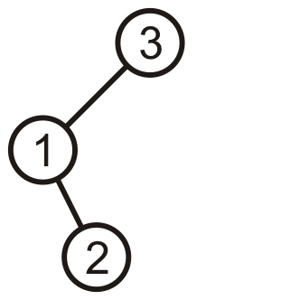
Prototypical Examples
Again, the product is a linked list; however, we can fix this, too

Slide 16
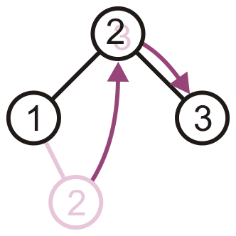
Prototypical Examples
Promote 2 to the root, and assign 1 and 3 to be its children

Slide 17
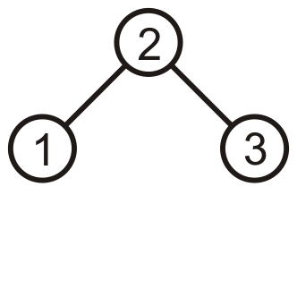
Prototypical Examples
The result is, again, a perfect tree
These examples may seem trivial, but they are the basis for the corrections in the next data structure we will see: AVL trees

Slide 18
AVL Tree (Bonus material: etymology)
Invented by Georgy Adelson-Velsky and Evgenii Landis in 1962

Slide 19
AVL Trees
Balance is defined by comparing the height of the two sub-trees
Recall:
An empty tree has height –1
A tree with a single node has height 0

Slide 20
AVL Trees
A binary search tree is said to be AVL balanced if:
The difference in the heights between the left and right sub-trees is at most 1, and
Both sub-trees are themselves AVL trees

Slide 21
Definition for Balance
We must develop a quantitative definition of balance which can be applied
Balanced may be defined by:
Height balancing: comparing the heights of the two sub trees
Null-path-length balancing: comparing the null-path-length of each of the two sub-trees (the length to the closest null sub-tree/empty node)
Weight balancing: comparing the number of null sub-trees in each of the two sub trees
Mathematically it can proved that if a tree satisfies the definition of balance, its height is Ο(ln(n))

Slide 22
The AVL Tree Data Structure
An AVL tree is a self-balancing binary search tree.
Structural properties
Binary tree property (same as BST)
Order property (same as for BST)
Balance condition: balance of every node is between -1 and 1 (-1, 0 , 1) where balance(node/factor) = height(node.left) – height(node.right)
https://en.wikipedia.org/wiki/Self-balancing_binary_search_tree

Slide 23
Example #1: Is this an AVL Tree?
Balance Condition: balance of every node is between -1 and 1 where balance(node) = height(node.left) – height(node.right)
6
4
8
1
7
11
10
12

Slide 24
Example #2: Is this an AVL Tree?
6
Balance Condition: balance of every node is between -1 and 1 where balance(node) = height(node.left) – height(node.right)
4
8
1
5
7
11
3
2

Slide 25
AVL Trees
Good News:
Because height of AVL tree is O(log(n)), then find
But as we insert and delete elements, we need to:

Slide 26
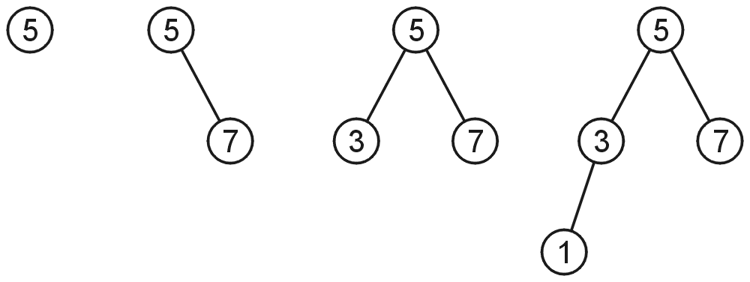
AVL Trees
AVL trees with 1, 2, 3, and 4 nodes:

Slide 27
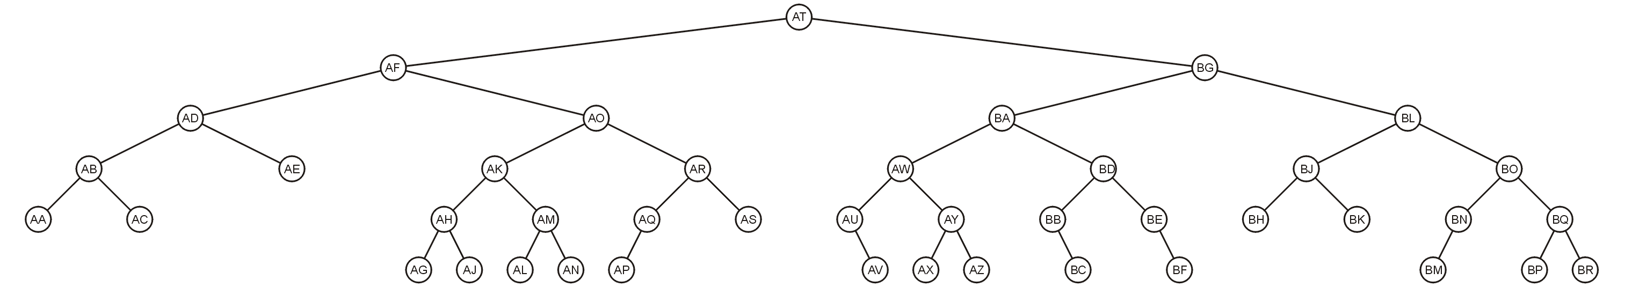
AVL Trees
Here is a larger AVL tree (42 nodes):

Slide 28
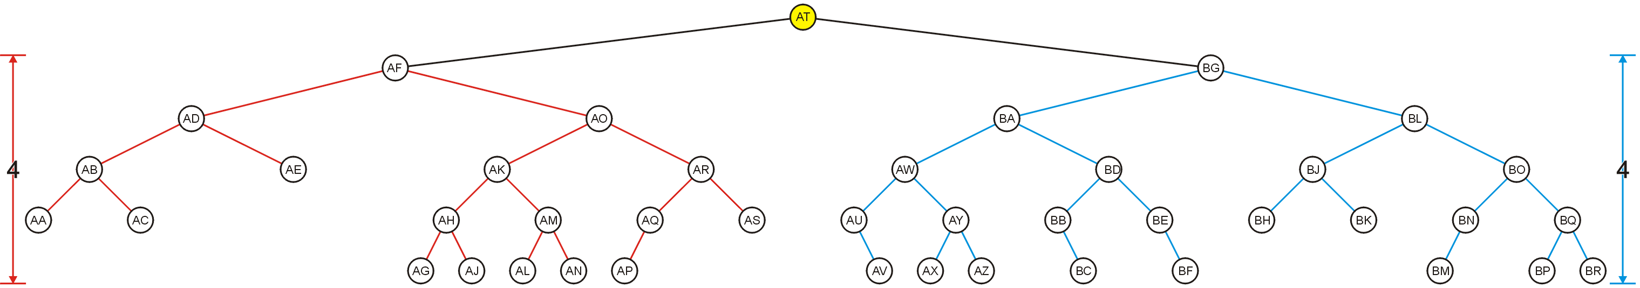
AVL Trees
The root node is AVL-balanced:
Both sub-trees are of height 4:

Slide 29
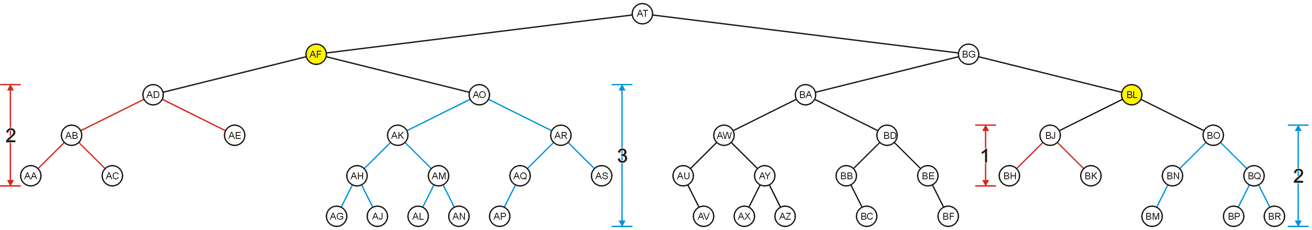
AVL Trees
All other nodes are AVL balanced
The sub-trees differ in height by at most one

Slide 30
Height of an AVL Tree
By the definition of complete trees, any complete binary search tree is an AVL tree
Thus an upper bound on the number of nodes in an AVL tree of height h a perfect binary tree with 2^{h + 1} – 1 nodes
What is an lower bound?

Slide 31
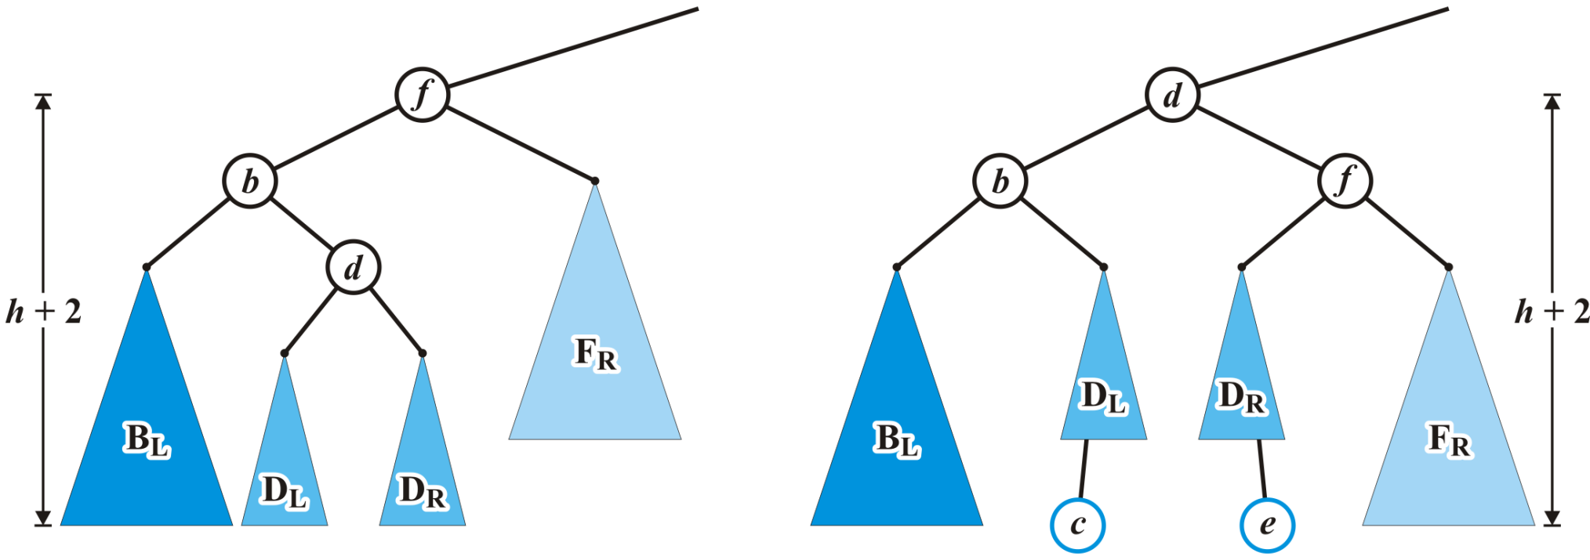
Maintaining Balance: Case 2
Again, the height of the root did not change

Slide 32
Height of an AVL Tree
Let F(h) be the fewest number of nodes in a tree of height h
From a previous slide:
F(0) = 1
F(1) = 2
F(2) = 4
Can we find F(h)?

Slide 33
Height of an AVL Tree
The worst-case AVL tree of height h would have:
A worst-case AVL tree of height h – 1 on one side,
A worst-case AVL tree of height h – 2 on the other, and
The root node
We get: F(h) = F(h – 1) + 1 + F(h – 2)

Slide 34
Height of an AVL Tree
This is a recurrence relation:
The solution?

Slide 35
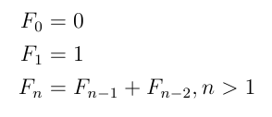
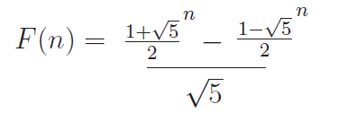
Fibonacci Numbers

Slide 36
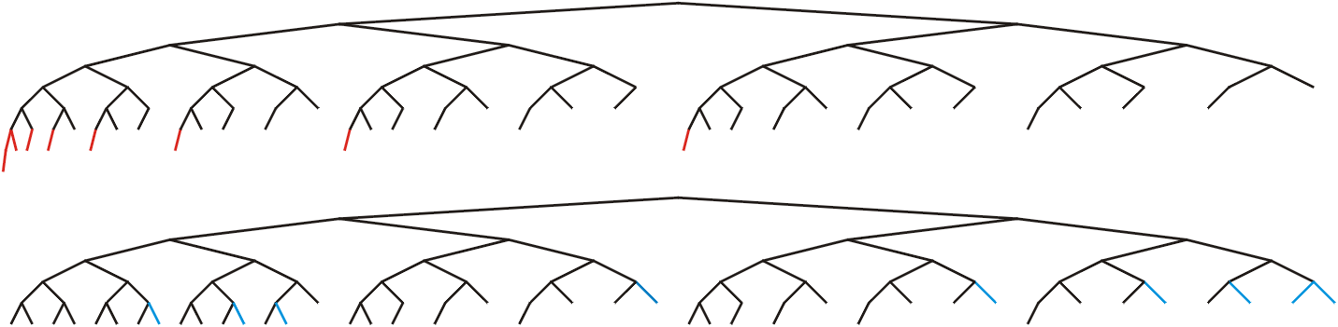
Height of an AVL Tree
In this example, n = 88, the worst- and best-case scenarios differ in height by only 2

Slide 37
Height of an AVL Tree
Fact: The height of an AVL tree storing n keys is O(log n).
Proof: Let us bound n(h): the minimum number of internal nodes of an AVL tree of height h.
We easily see that n(1) = 1 and n(2) = 2
For n > 2, an AVL tree of height h contains the root node, one AVL subtree of height h-1 and another of height h-2.
That is, n(h) = 1 + n(h-1) + n(h-2)
Knowing n(h-1) > n(h-2), we get n(h) > 2n(h-2). So
n(h) > 2n(h-2), n(h) > 4n(h-4), n(h) > 8n(n-6), … (by induction),
n(h) > 2^{i}n(h-2i)
Solving the base case we get: n(h) > 2 ^{h/2-1}
Taking logarithms: h < 2log n(h) +2
Thus the height of an AVL tree is O(log n)
n(2)
3
4
n(1)

Slide 38
AVL tree operations
AVL find:
Same as usual BST find
AVL insert:
AVL delete:
The “easy way” is lazy deletion
Otherwise, do the deletion and then check for several imbalance cases (we will skip this)

Slide 39
Maintaining Balance
To maintain AVL balance, observe that:
Inserting a node can increase the height of a tree by at most 1
Removing a node can decrease the height of a tree by at most 1

Slide 40
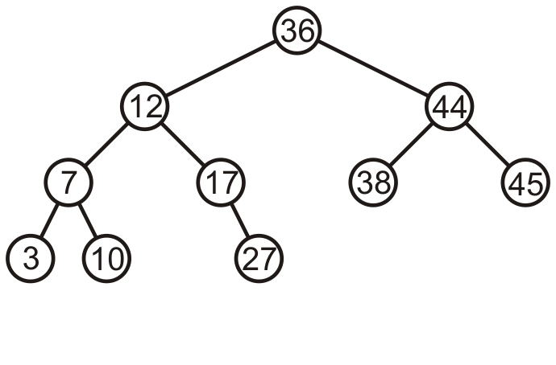
Maintaining Balance
Consider this AVL tree

Slide 41
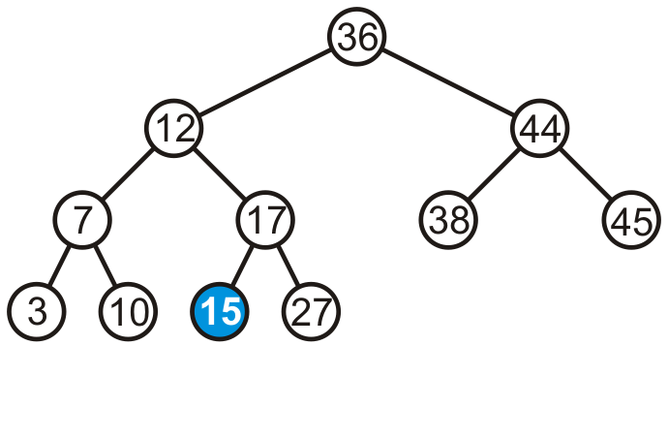
Maintaining Balance
Consider inserting 15 into this tree
In this case, the heights of none of the trees change

Slide 42
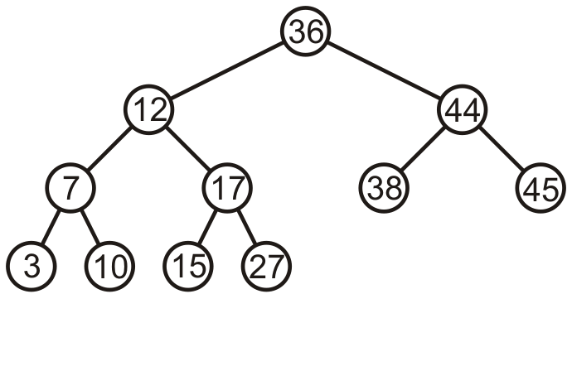
Maintaining Balance
The tree remains balanced

Slide 43
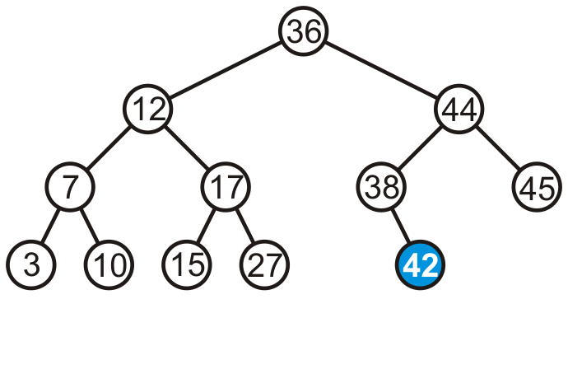
Maintaining Balance
Consider inserting 42 into this tree
In this case, the heights of none of the trees change

Slide 44
Maintaining Balance
If a tree is AVL balanced, for an insertion to cause an imbalance:
The heights of the sub-trees must differ by 1
The insertion must increase the height of the deeper sub-tree by 1

Slide 45
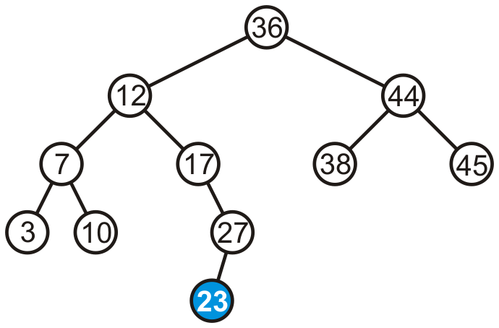
Maintaining Balance
Suppose we insert 23 into our initial tree

Slide 46
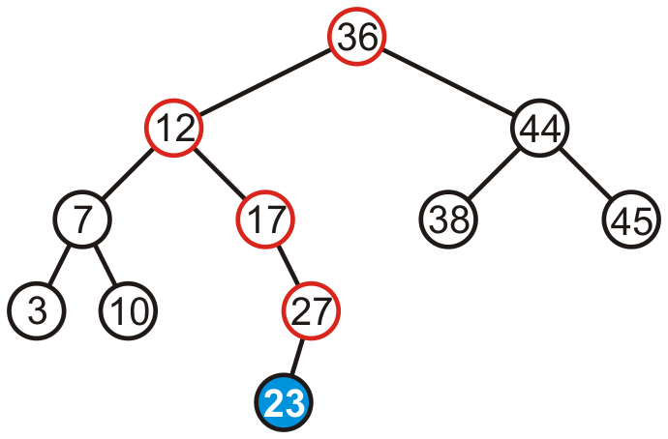
Maintaining Balance
The heights of each of the sub-trees from here to the root are increased by one

Slide 47
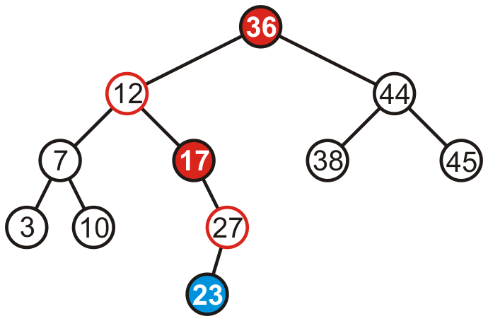
Maintaining Balance
However, only two of the nodes are unbalanced: 17 and 36

Slide 48
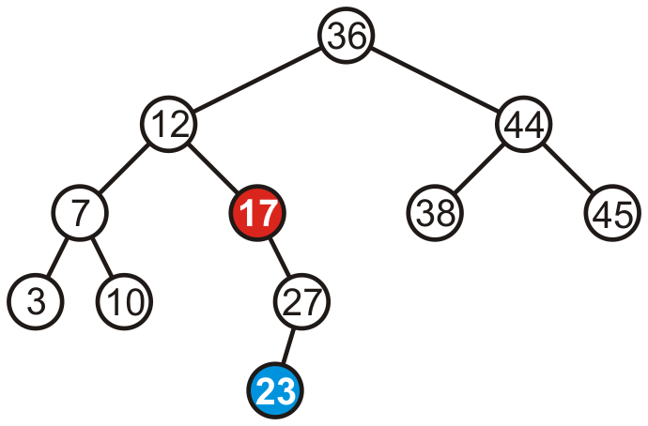
Maintaining Balance
However, only two of the nodes are unbalanced: 17 and 36
We only have to fix the imbalance at the lowest node

Slide 49
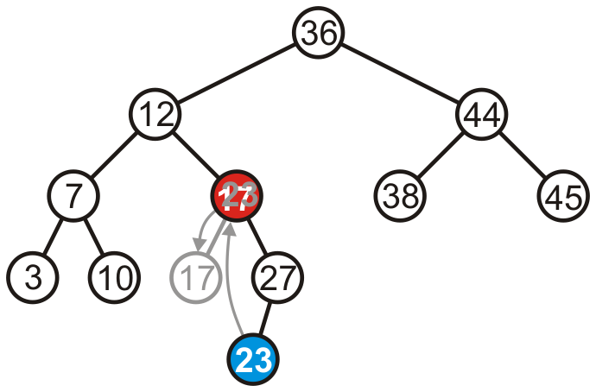
Maintaining Balance
We can promote 23 to where 17 is, and make 17 the left child of 23

Slide 50
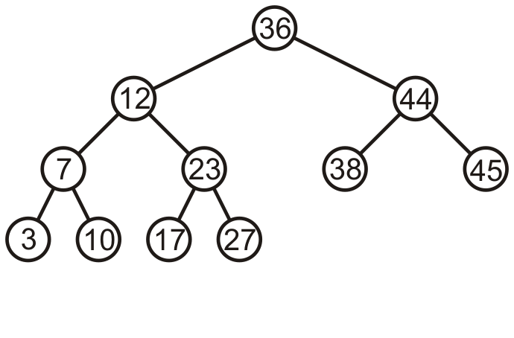
Maintaining Balance
Thus, that node is no longer unbalanced
Incidentally, neither is the root now balanced again, too

Slide 51
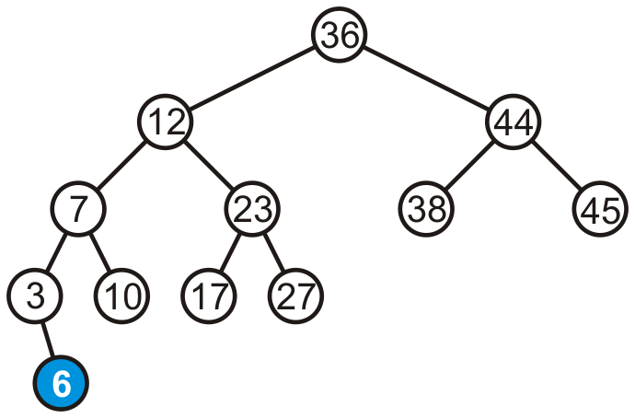
Maintaining Balance
Consider adding 6:

Slide 52
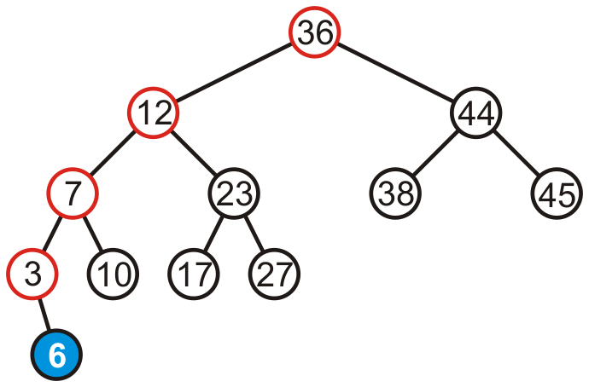
Maintaining Balance
The height of each of the trees in the path back to the root are increased by one

Slide 53
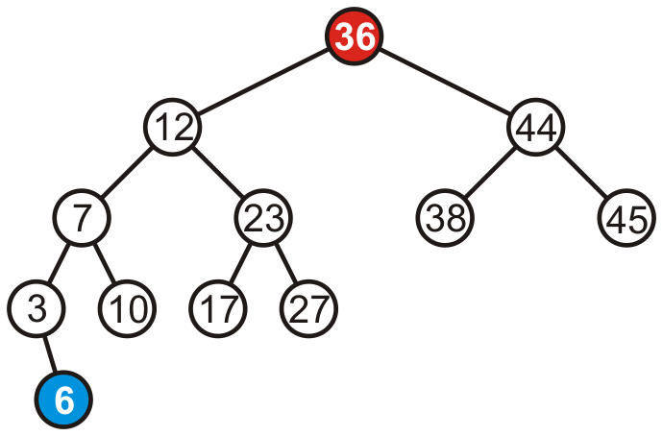
Maintaining Balance
The height of each of the trees in the path back to the root are increased by one
However, only the root node is now unbalanced

Slide 54
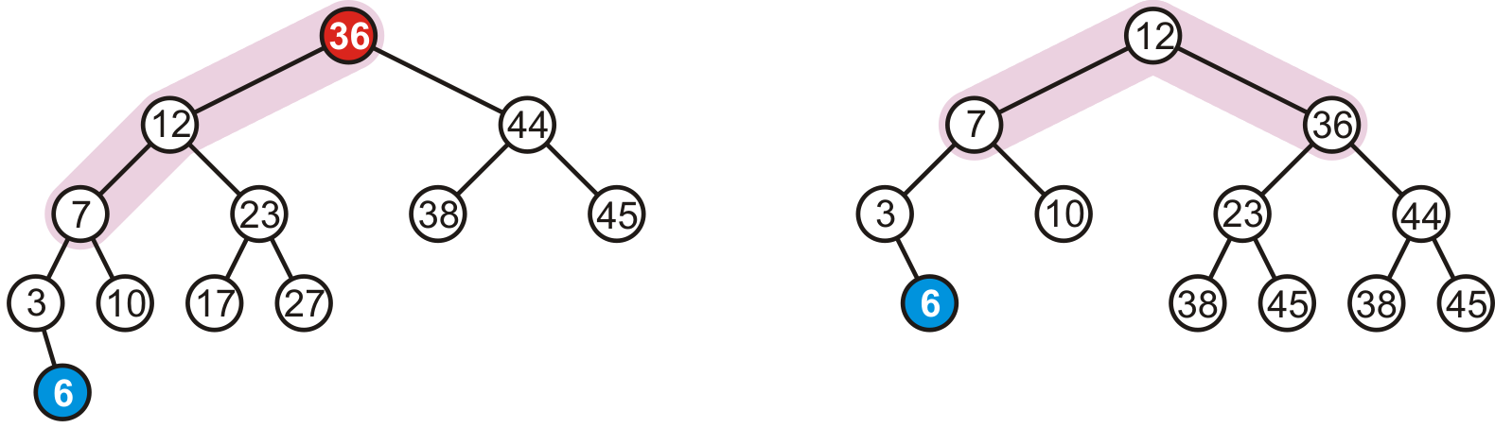
Maintaining Balance
We may fix this by rotating the root to the right
Note: the right subtree of 12 became the left subtree of 36

Slide 55
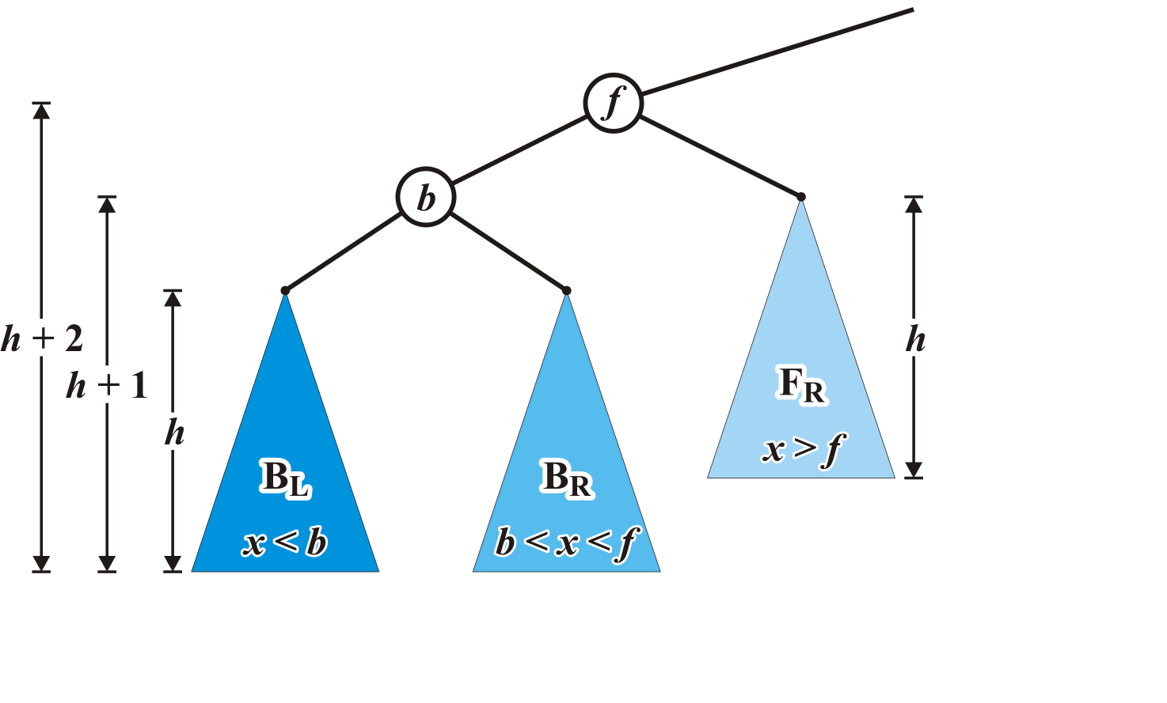
Case 1 setup
Consider the following setup
Each blue triangle represents a tree of height h

Slide 56
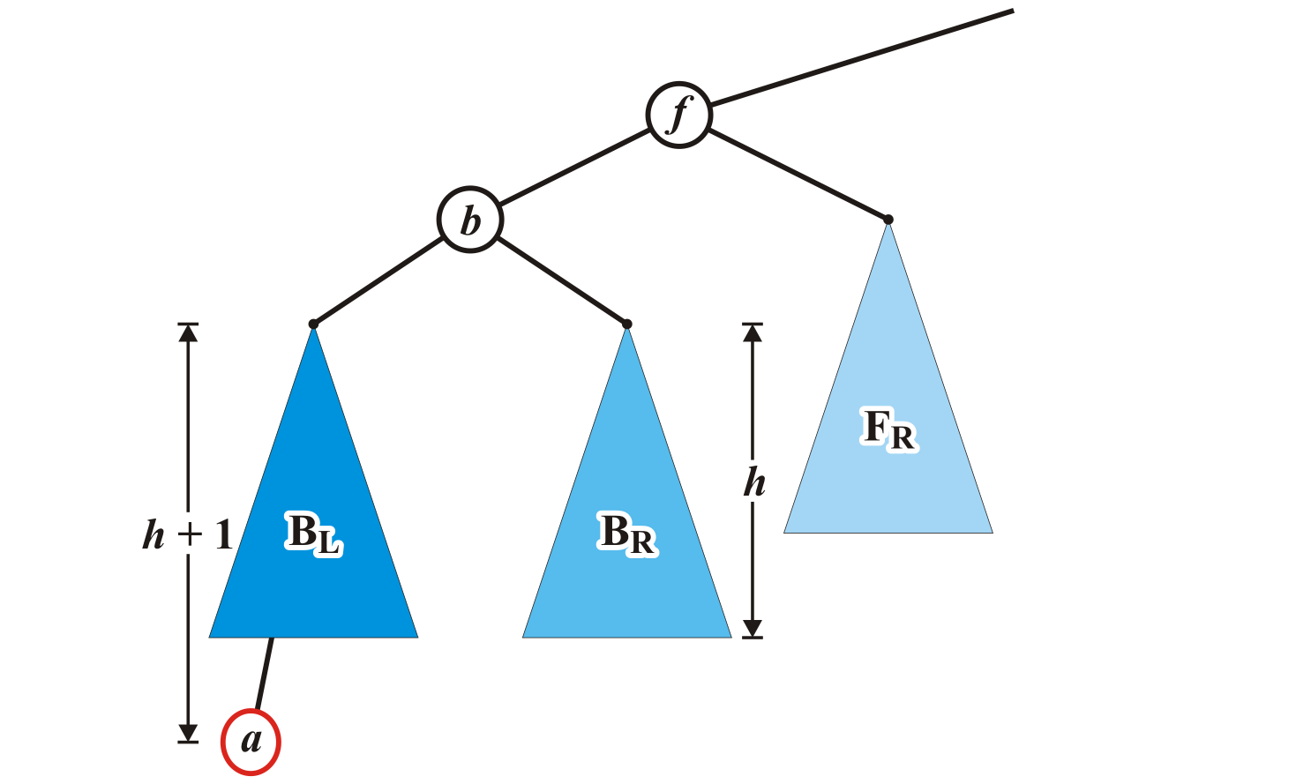
Maintaining Balance: Case 1
Insert a into this tree: it falls into the left subtree B_{L} of b
Assume B_{L} remains balanced
Thus, the tree rooted at b is also balanced
Left subtree of left child

Slide 57
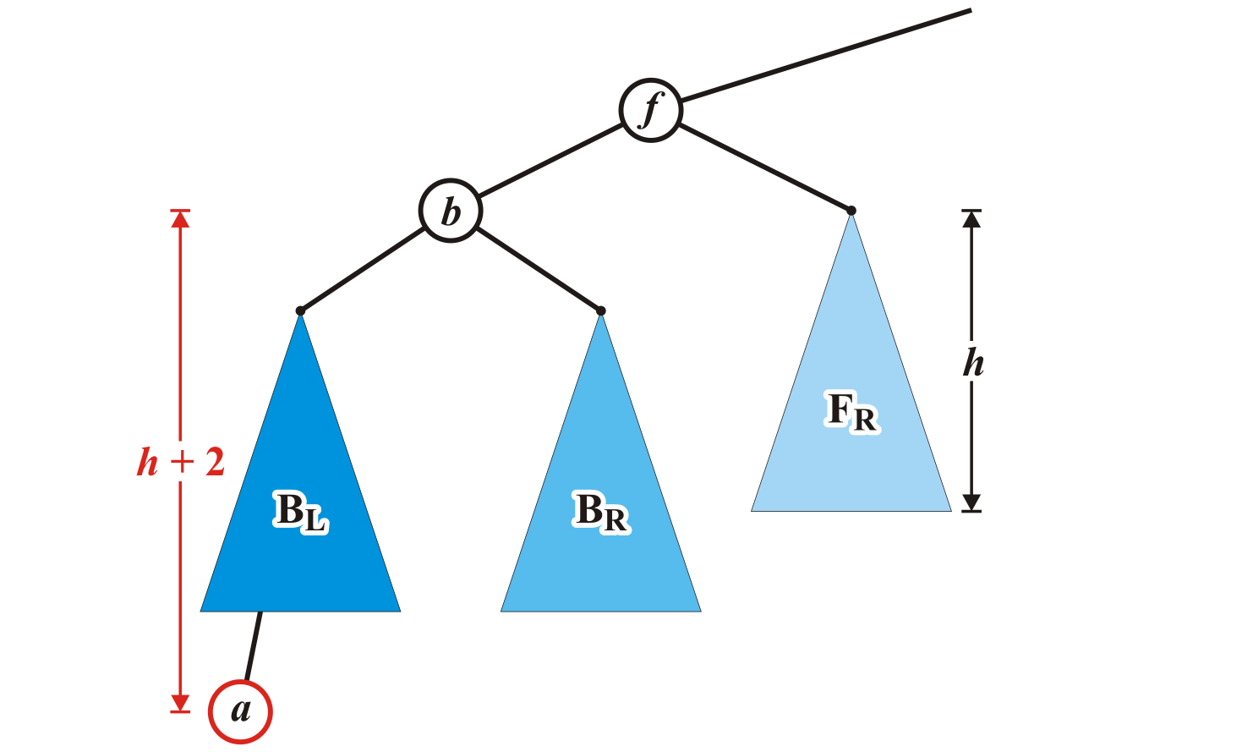
Maintaining Balance: Case 1
The tree rooted at node f is now unbalanced
We will correct the imbalance at this node

Slide 58
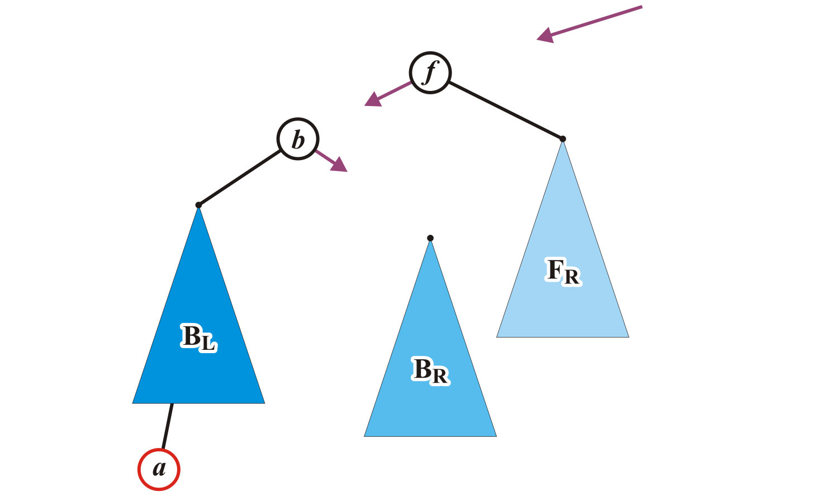
Maintaining Balance: Case 1
We will modify these three pointers:

Slide 59
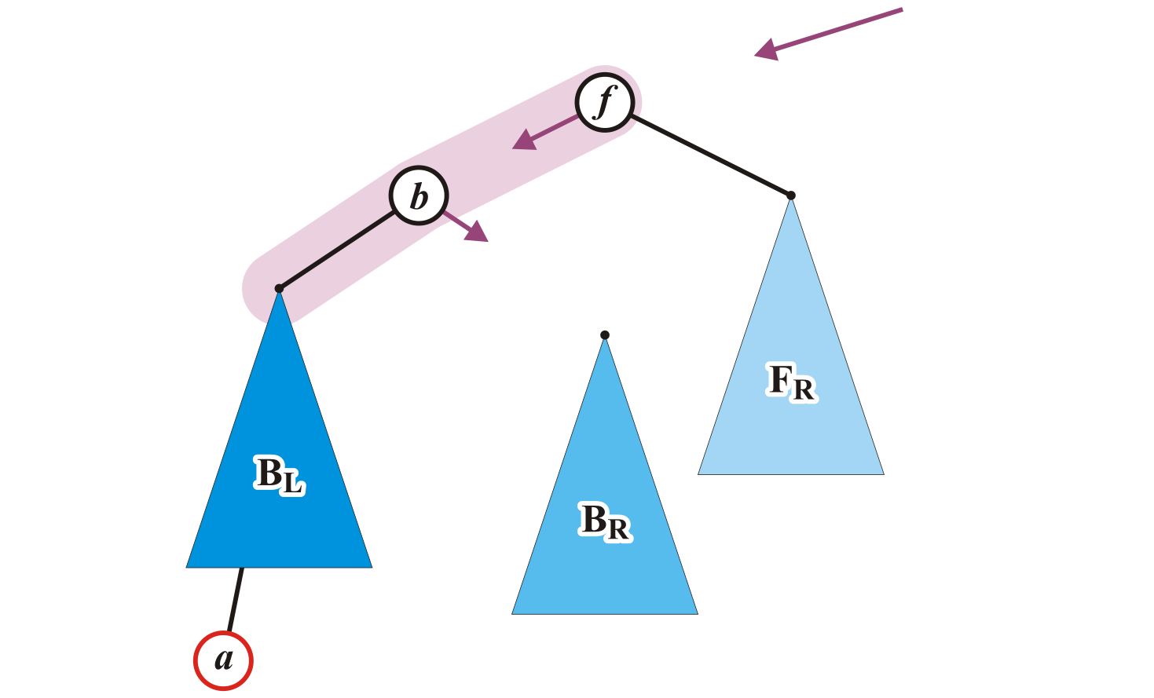
Maintaining Balance: Case 1
Specifically, we will rotate these two nodes around the root:
Recall the first prototypical example
Promote node b to the root and demote node f to be the right child of b

Slide 60
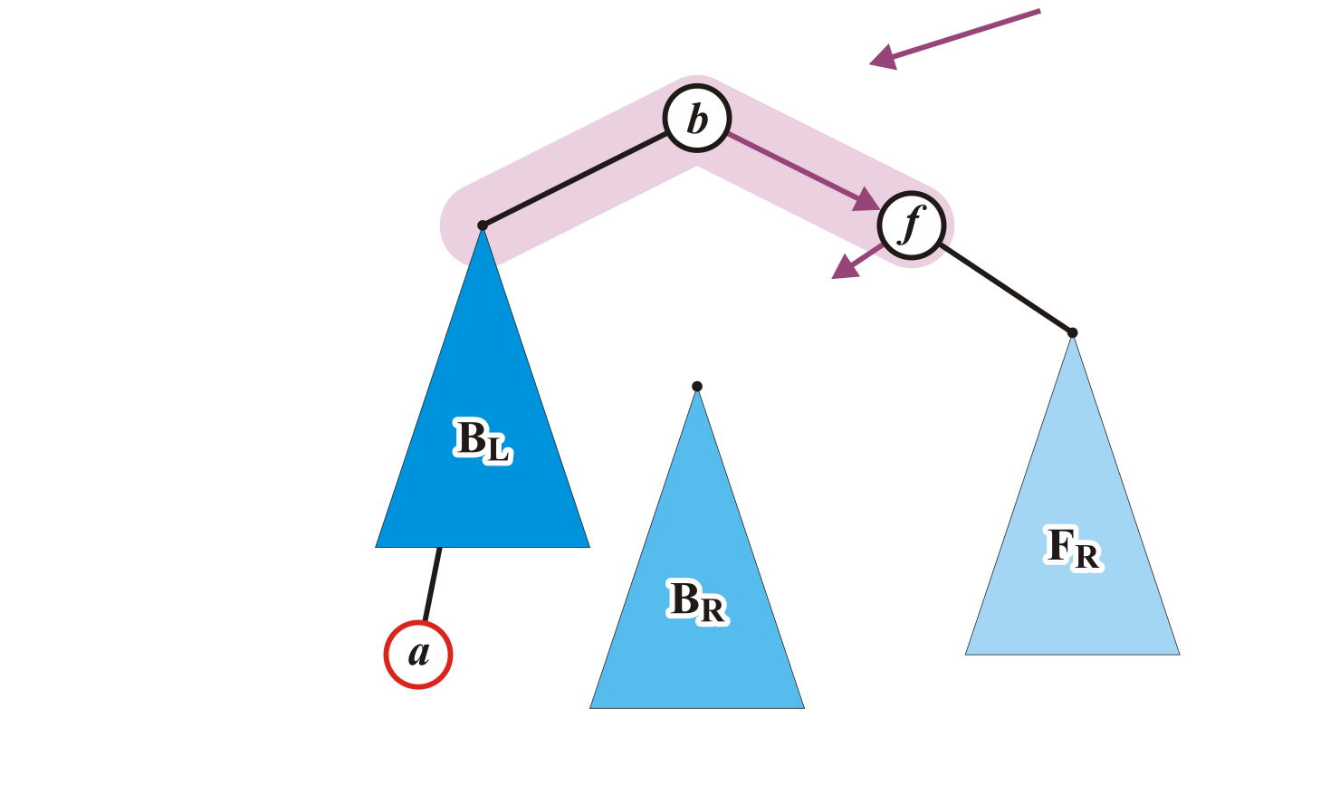
Maintaining Balance: Case 1
Make f the right child of b

Slide 61
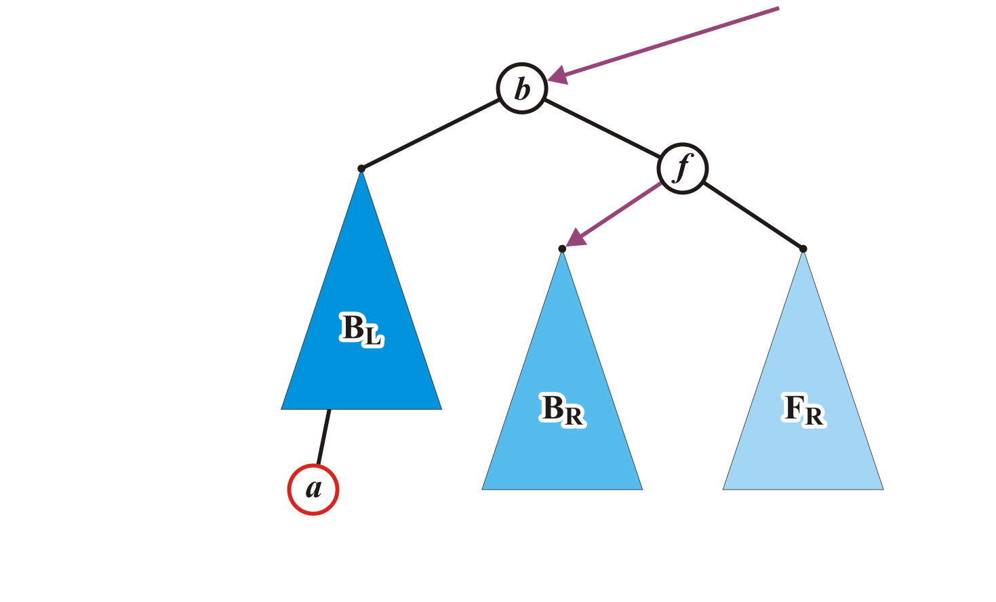
Maintaining Balance: Case 1
Assign former parent of node f to point to node b
Make B_{R} left child of node f

Slide 62
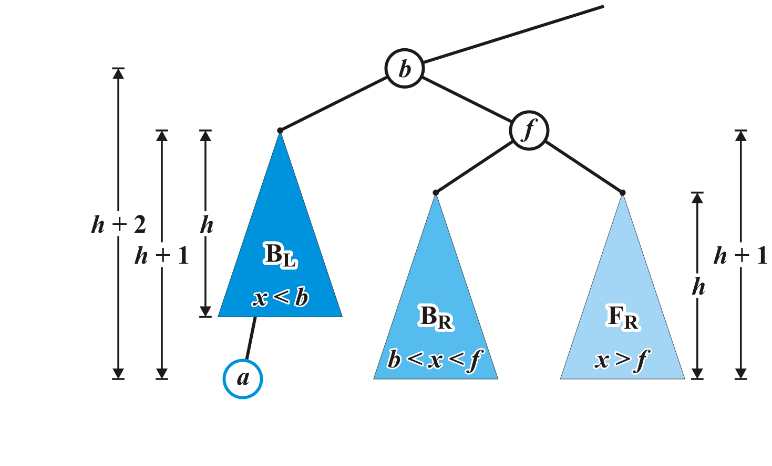
Maintaining Balance: Case 1
The nodes b and f are now balanced and all remaining nodes of the subtrees are in their correct positions

Slide 63
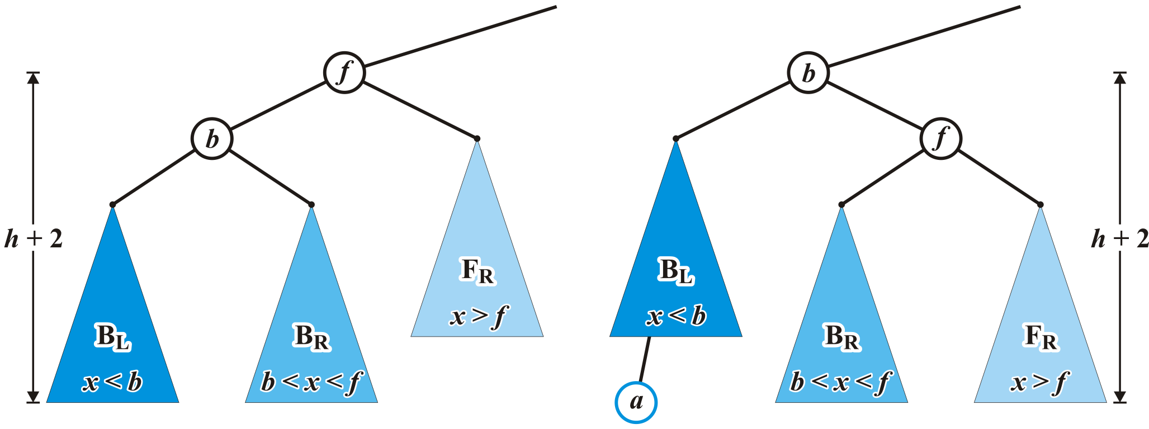
Maintaining Balance: Case 1
Additionally, height of the tree rooted at b equals the original height of the tree rooted at f
Thus, this insertion will no longer affect the balance of any ancestors all the way back to the root

Slide 64
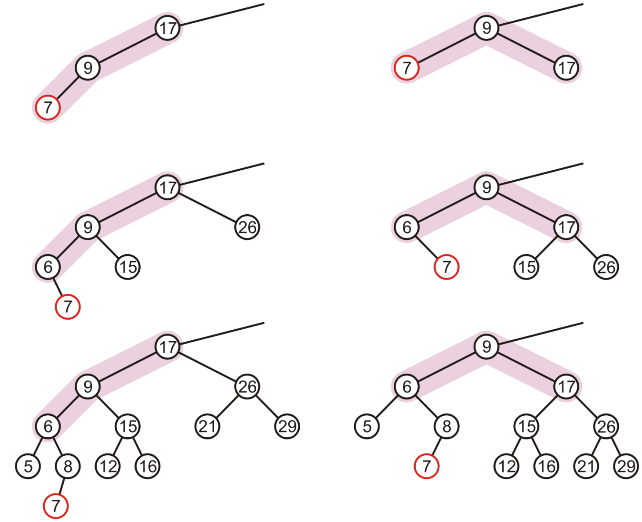
More Examples

Slide 65
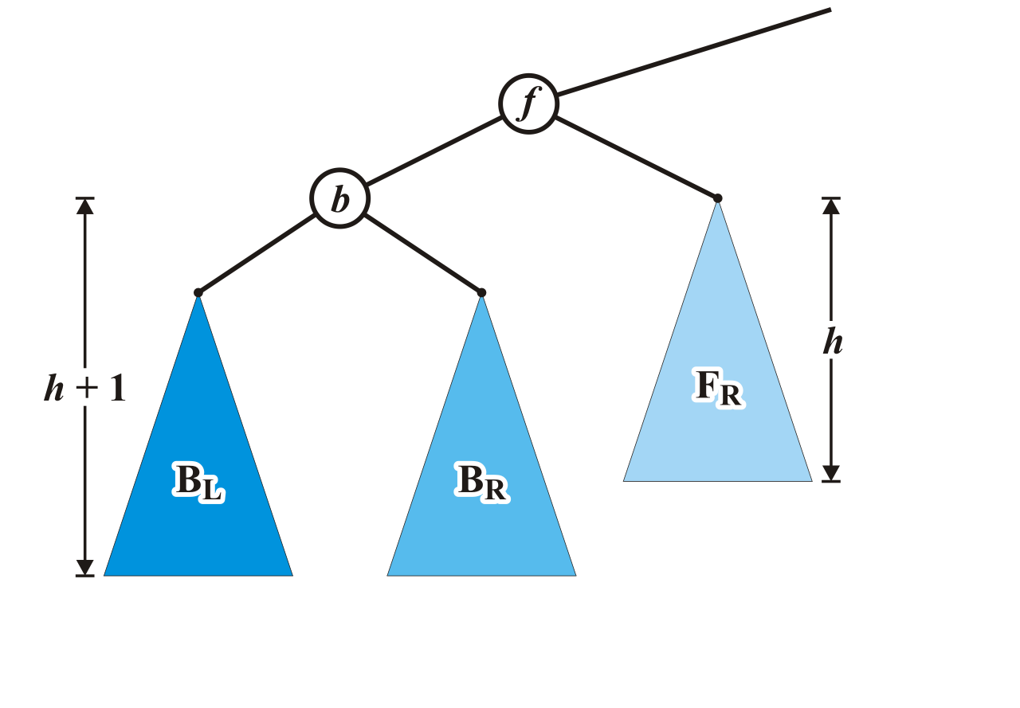
Maintaining Balance: Case 2
Alternatively, consider the insertion of c where b < c < f into our original tree

Slide 66
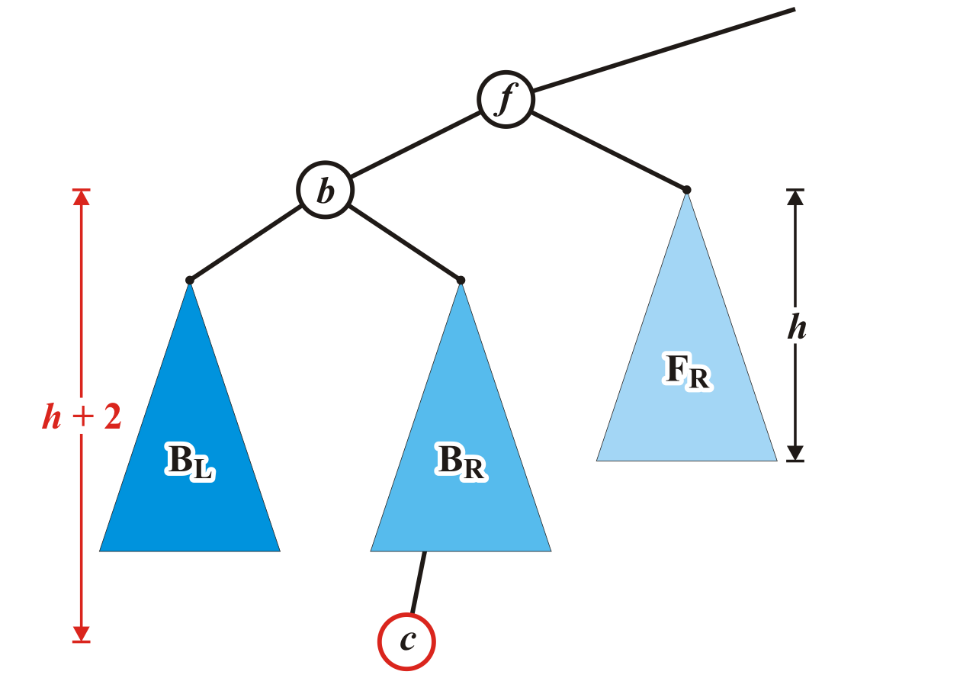
Maintaining Balance: Case 2
Assume that the insertion of c increases the height of B_{R}
Once again, f becomes unbalanced
Right subtree of left child

Slide 67
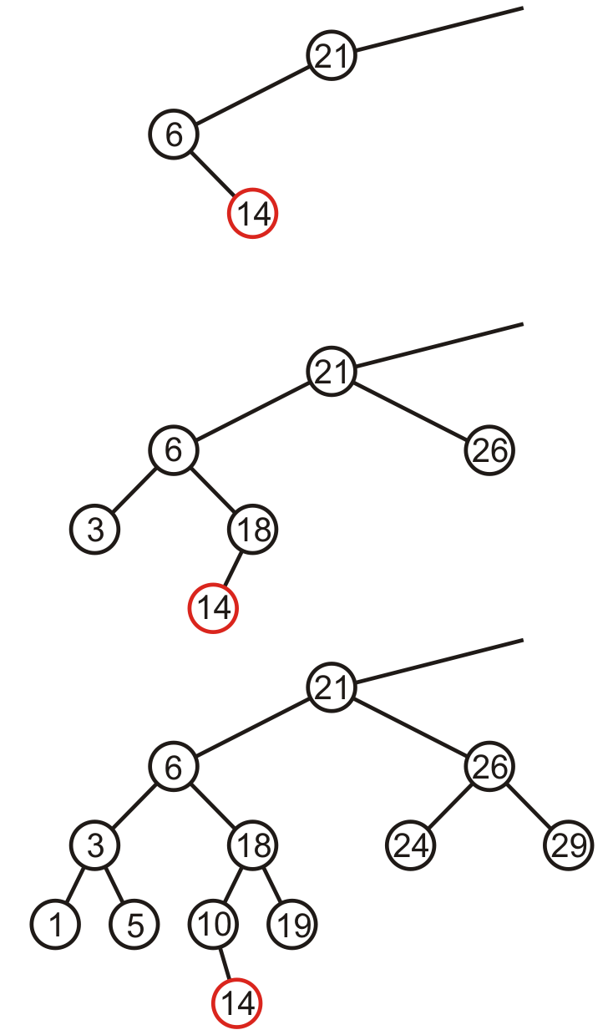
Maintaining Balance: Case 2
Here are examples of when the insertion of 14 may cause this situation when h = –1, 0, and 1

Slide 68
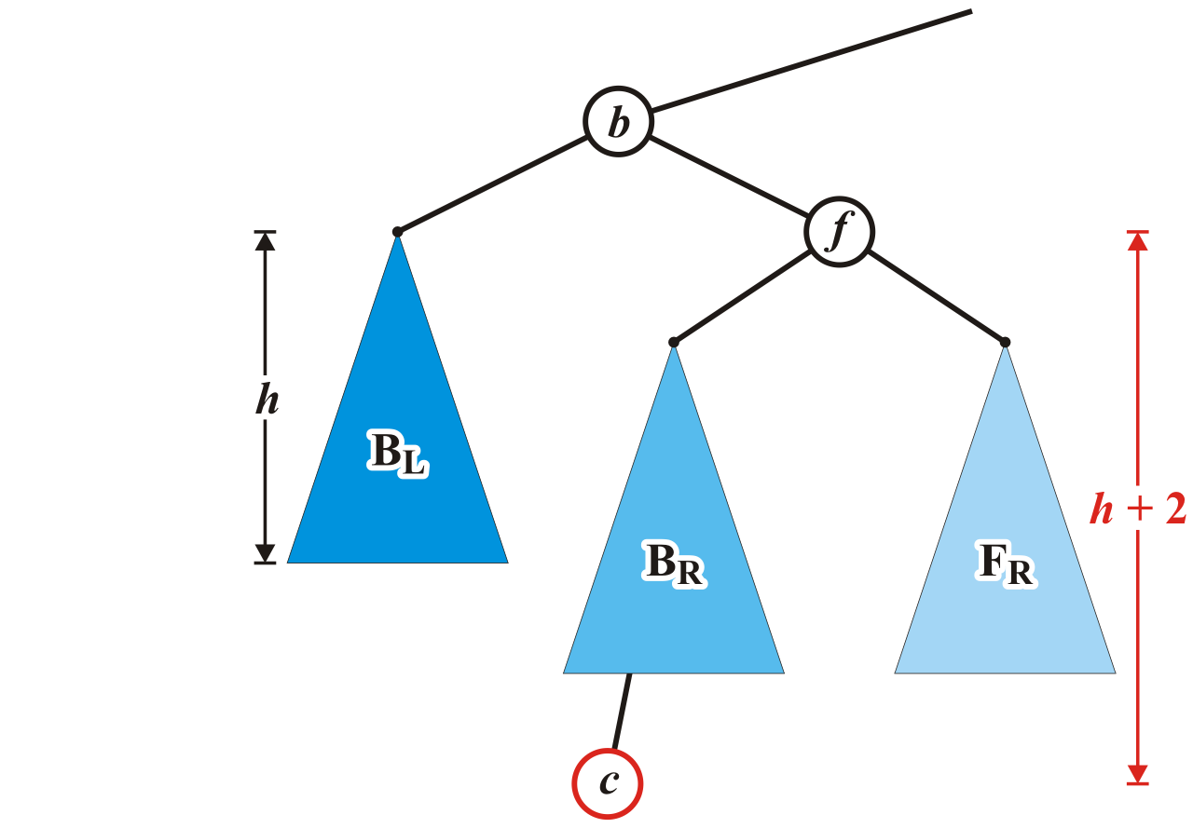
Maintaining Balance: Case 2
Unfortunately, the previous correction does not fix the imbalance at the root of this sub-tree: the new root, b, remains unbalanced

Slide 69
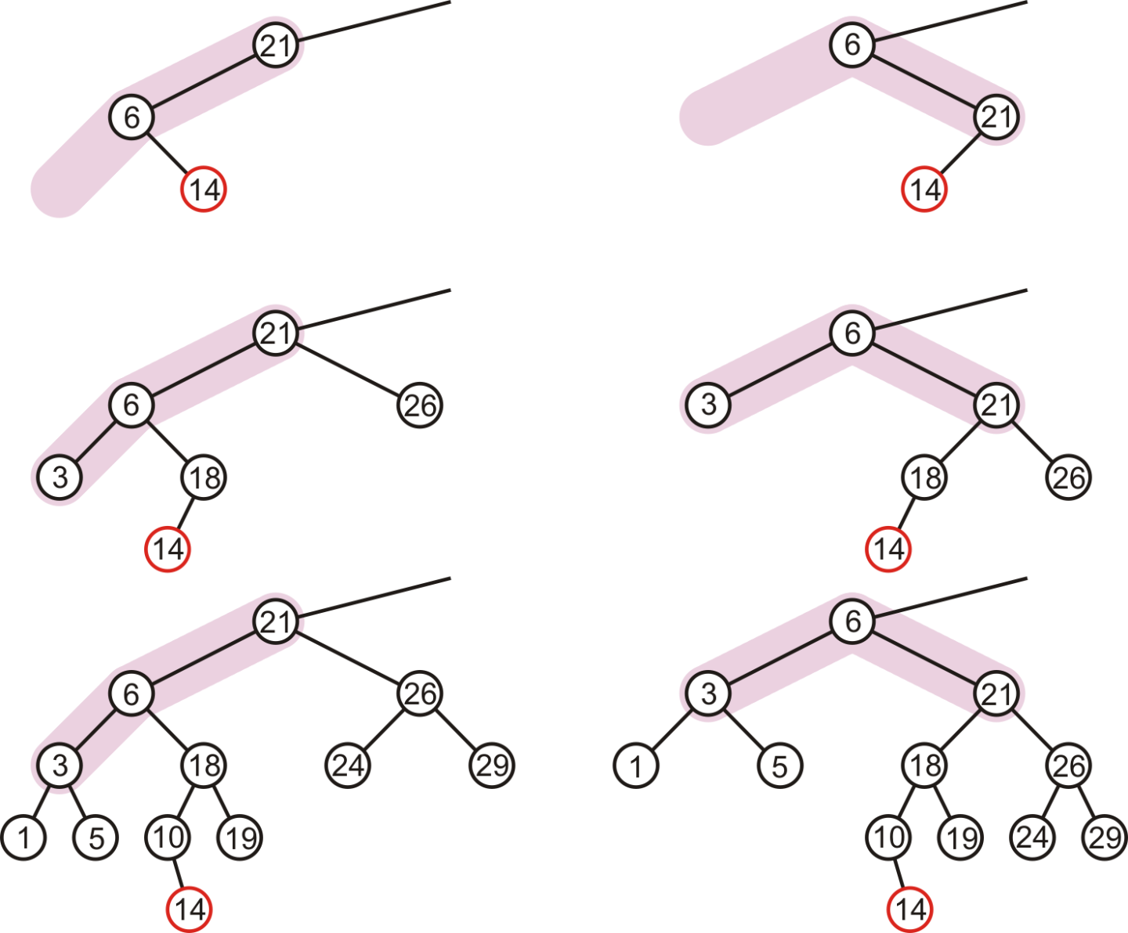
Maintaining Balance: Case 2
In our three sample cases with h = –1, 0, and 1, doing the same thing as before results in a tree that is still unbalanced…
The imbalance is just shifted to the other side

Slide 70
Maintaining Balance: Case 2
Lets start over …

Slide 71
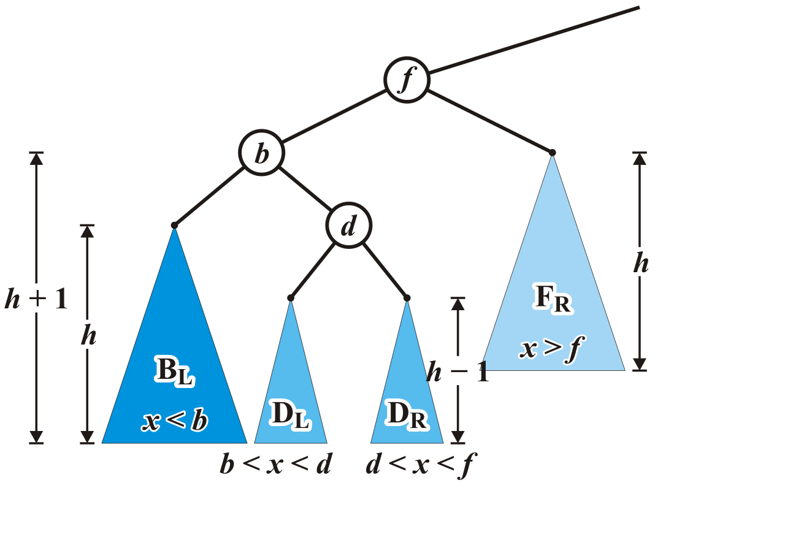
Maintaining Balance: Case 2
Re-label the tree by dividing the left subtree of f into a tree rooted at d with two subtrees of height h – 1

Slide 72
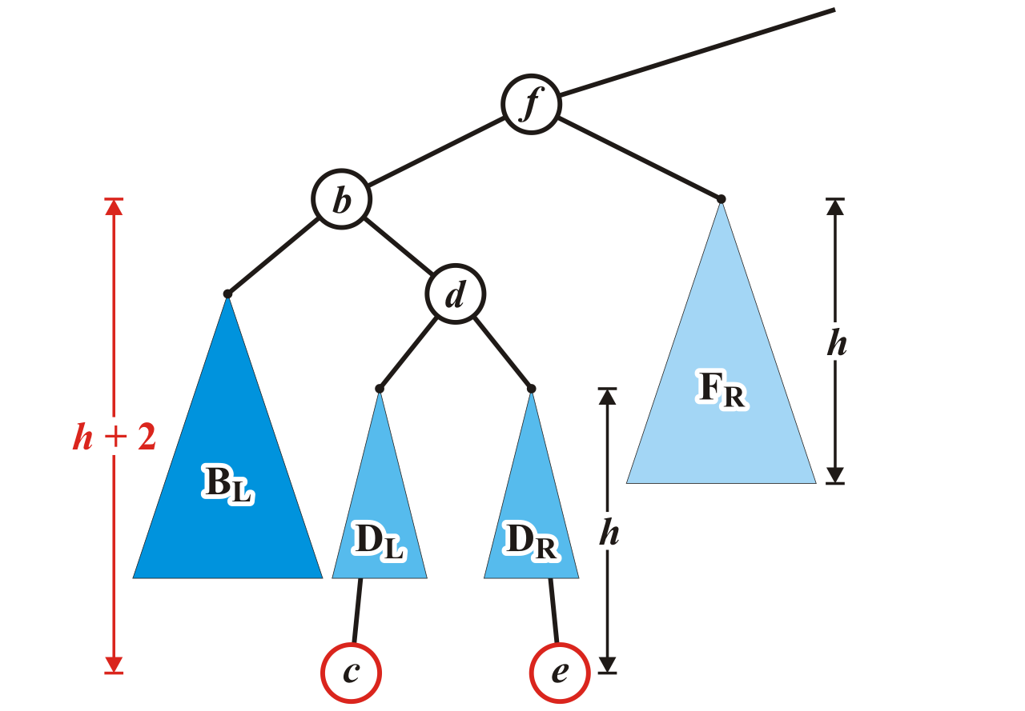
Maintaining Balance: Case 2
Now an insertion causes an imbalance at f
The addition of either c or e will cause this

Slide 73
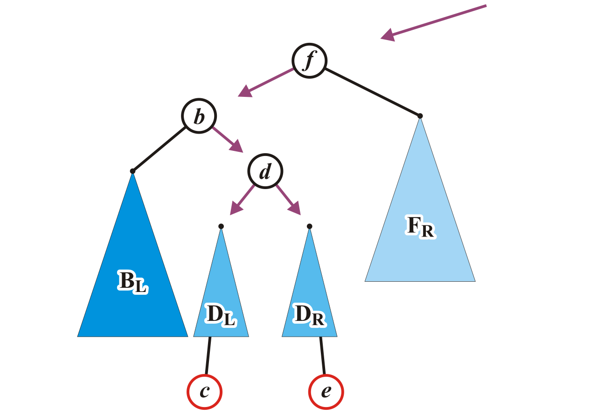
Maintaining Balance: Case 2
We will reassign the following pointers

Slide 74
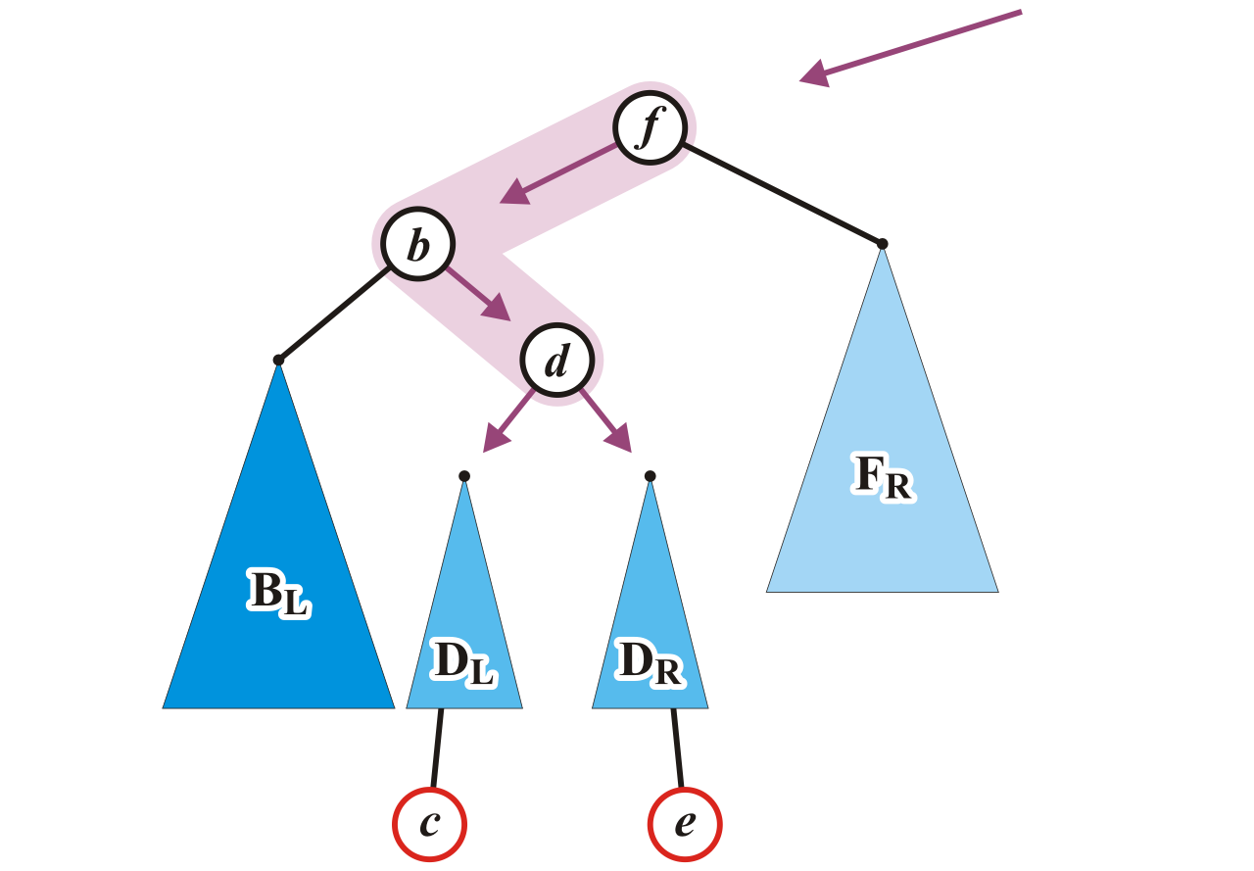
Maintaining Balance: Case 2
Specifically, we will order these three nodes as a perfect tree
Recall the second prototypical example

Slide 75
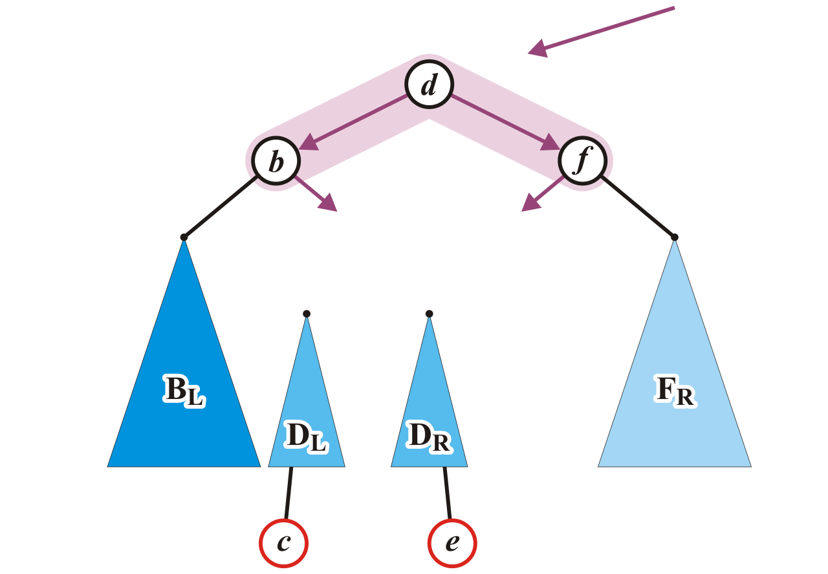
Maintaining Balance: Case 2
To achieve this, b and f will be assigned as children of the new root d

Slide 76

Maintaining Balance: Case 2
We also have to connect the two subtrees and original parent of f

Slide 77

Maintaining Balance: Case 2
Now the tree rooted at d is balanced

Slide 78

Maintaining Balance: Case 2
In our three sample cases with h = –1, 0, and 1, the node is now balanced and the same height as the tree before the insertion
14

Slide 79


Maintaining balance: Summary
There are two symmetric cases to those we have examined:
Insertions into the right-right sub-tree
-- Insertions into either the right-left sub-tree

Slide 80

More examples : Insertion
Consider this AVL tree

Slide 81

Insertion
Insert 73

Slide 82

Insertion
The node 81 is unbalanced
A left-left imbalance

Slide 83
Insertion
The node 81 is unbalanced
A left-left imbalance

Slide 84
Insertion
The node 81 is unbalanced
A left-left imbalance
Promote the intermediate node to the imbalanced node

Slide 85
Insertion
The node 81 is unbalanced
A left-left imbalance
Promote the intermediate node to the imbalanced node
75 is that node

Slide 86

Insertion
The node 81 is unbalanced
A left-left imbalance
Promote the intermediate node to the imbalanced node
75 is that node

Slide 87

Insertion
The tree is AVL balanced

Slide 88

Insertion
Insert 77

Slide 89

Insertion
The node 87 is unbalanced
A left-right imbalance

Slide 90
Insertion
The node 87 is unbalanced
A left-right imbalance

Slide 91
Insertion
The node 87 is unbalanced
A left-right imbalance
Promote the intermediate node to the imbalanced node

Slide 92
Insertion
The node 87 is unbalanced
A left-right imbalance
Promote the intermediate node to the imbalanced node
81 is that value

Slide 93

Insertion
The node 87 is unbalanced
A left-right imbalance
Promote the intermediate node to the imbalanced node
81 is that value

Slide 94

Insertion
The tree is balanced

Slide 95

Insertion
Insert 76

Slide 96

Insertion
The node 78 is unbalanced
A left-left imbalance

Slide 97

Insertion
The node 78 is unbalanced
Promote 77

Slide 98

Insertion
Again, balanced

Slide 99

Insertion
Insert 80

Slide 100

Insertion
The node 69 is unbalanced
A right-left imbalance
Promote the intermediate node to the imbalanced node

Slide 101

Insertion
The node 69 is unbalanced
A left-right imbalance
Promote the intermediate node to the imbalanced node
75 is that value

Slide 102

Insertion
Again, balanced

Slide 103

Insertion
Insert 74

Slide 104

Insertion
The node 72 is unbalanced
A right-right imbalance
Promote the intermediate node to the imbalanced node
75 is that value

Slide 105

Insertion
The node 72 is unbalanced
A right-right imbalance
Promote the intermediate node to the imbalanced node

Slide 106

Insertion
Again, balanced

Slide 107

Insertion
Insert 55

Slide 108

Insertion
The node 69 is imbalanced
A left-left imbalance
Promote the intermediate node to the imbalanced node
This is mistake, there are three imbalanced nodes as 51 (root), 69 and 63. We
Need to balance 63 first.
Notes:
51, 30, 75, 18, 12, 15, 24, 21, 27, 42, 36, 33, 39, 45, 48, 69, 63, 57, 54, 60, 66, 73, 72, 74, 81, 77, 87, 76, 78, 80, 81, 87, 84, 93, 90, 96

Slide 109

Insertion
The node 69 is imbalanced
A left-left imbalance
Promote the intermediate node to the imbalanced node
63 is that value

Slide 110

Insertion
Insert 55
No imbalances

Slide 111

Insertion
Again, balanced

Slide 112

Insertion
Again, balanced

Slide 113

Insertion
Insert 70

Slide 114

Insertion
The root node is now imbalanced
A right-left imbalance
Promote the intermediate node to the root
75 is that value

Slide 115

Insertion
The root node is imbalanced
A right-left imbalance
Promote the intermediate node to the root
63 is that node

Slide 116

Insertion
The result is balanced

Slide 117
Summary: Insertions
Let the node that needs rebalancing be j.
There are 4 cases:
Outside Cases (require single rotation) :
1. Insertion into left subtree of left child of j.
2. Insertion into right subtree of right child of j.
Inside Cases (require double rotation) :
3. Insertion into right subtree of left child of j.
4. Insertion into left subtree of right child of j.
The rebalancing is performed through four separate rotation algorithms.

Slide 118
Outside Case
Left subtree of left child
Inside Case
Right subtree of left child
Single “right” Rotation
“left-right” Double Rotation

Slide 119
Inside Case Recap
j
k
h
Z
h
h
X
Y

Slide 120
AVL Insertion: Inside Case
Consider the structure
of subtree Y…
j
k
h
Z
h
h+1
X
Y

Slide 121
AVL Insertion: Inside Case
j
k
h
Z
i
h
h+1
X
h or h-1
V
W

Slide 122
AVL Insertion: Inside Case
j
We will do a left-right
“double rotation” . . .
k
Z
i
X
V
W

Slide 123
Double rotation : first rotation
j
left rotation complete
i
Z
k
W
V
X

Slide 124
Double rotation : second rotation
j
Now do a right rotation
i
Z
k
W
V
X

Slide 125
Double rotation : second rotation
right rotation complete
Balance has been
restored
i
k
j
h
h
h or h-1
V
X
W
Z

Slide 126
Implementation
balance (1,0,-1)
key
left
right
No need to keep the height; just the difference in height, i.e. the balance factor; this has to be modified on the path of insertion even if you don’t perform rotations
Once you have performed a rotation (single or double) you won’t need to go back up the tree

Slide 127
Insertion in AVL Trees
Insert at the leaf (as for all BST)
only nodes on the path from insertion point to root node have possibly changed in height
So after the Insert, go back up to the root node by node, updating heights
If a new balance factor (the difference h_{left}-h_{right}) is 2 or –2, adjust tree by rotation around the node
Correctness: Rotations preserve inorder traversal ordering

Slide 128
Delete
In deletion also, we delete the node to be deleted in the same way as we do with a normal binary search tree.
After that, we fix the unbalance of any ancestor node with suitable rotations.
The only thing is that unlike insertion, it might be possible that the unbalance propagates above the tree in deletion which makes us rebalance the ancestor nodes.

Slide 129
Delete in BST
https://www.geeksforgeeks.org/binary-search-tree-set-2-delete/

Slide 130
Delete
Removing a node from an AVL tree may cause more than one AVL imbalance
Like insert, erase must check after it has been successfully called on a child to see if it caused an imbalance
Unfortunately, it may cause multiple imbalances that must be corrected
Insertions will only cause one imbalance that must be fixed

Slide 131

Delete
Consider the following AVL tree

Slide 132

Delete
Suppose we erase the front node: 1

Slide 133

Delete
While its previous parent, 2, is not unbalanced, its grandparent 3 is
The imbalance is in the right-right subtree

Slide 134

Delete
We can correct this with a simple balance

Slide 135

Delete
The node of that subtree, 5, is now balanced

Slide 136

Delete
Recursing to the root, however, 8 is also unbalanced
This is a right-left imbalance

Slide 137

Delete
Promoting 11 to the root corrects the imbalance

Slide 138

Delete
At this point, the node 11 is balanced

Slide 139

Delete
Still, the root node is unbalanced
This is a right-right imbalance

Slide 140

Erase
Again, a simple balance fixes the imbalance

Slide 141

Delete
The resulting tree is now AVL balanced

Slide 142
Pros and Cons of AVL Trees
Arguments for AVL trees:
Search is O(log N) since AVL trees are always balanced.
Insertion and deletions are also O(logn)
The height balancing adds no more than a constant factor to the speed of insertion.
Arguments against using AVL trees:
Difficult to program & debug; more space for balance factor.
Asymptotically faster but rebalancing costs time.
Most large searches are done in database systems on disk and use other structures (e.g. B-trees).
May be OK to have O(N) for a single operation if total run time for many consecutive operations is fast (e.g. Splay trees).

